Slide 1
MLLMs Use Cases
Noah, William and Manami

Slide 2
Customer Service - Google Contact Center AI
References:
Contact Center AI Platform
Google Cloud Contact Center Artificial Intelligence (CCAI): A Managerial View

Slide 3
Use Case
Google Contact Center AI helps businesses automate customer service interactions using advanced voice-based models. The system can transcribe customer conversations, understand user intent, detect sentiment, and provide real-time suggestions to agents or fully automate responses using chatbots.

Slide 4
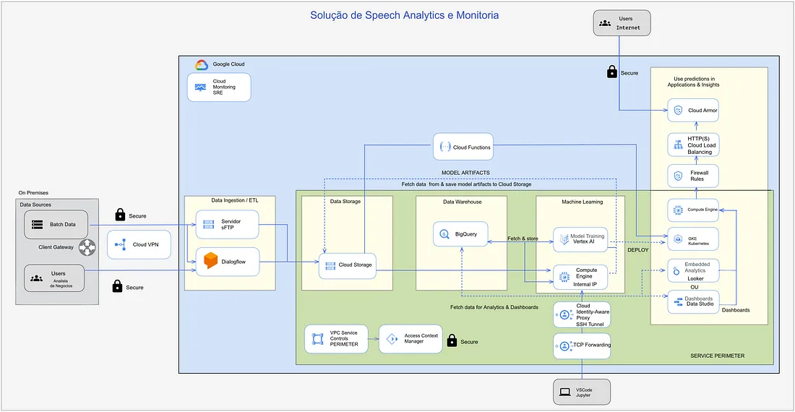
Diagram of Application’s Business Logic
Notes:
On the left we can see that they use AWS IAM for identity and access management, KMS for key management, Certificate Manager to manage SSL certificates and System Manager to manage & operate AWS resources. Across the top we can see the lake layers: Raw, Trusted (after validation) and Refined (after transformation and adjustments). The data lake is built and managed by AWS Lake Formation, including access management (authorisation and entitlement). They use Glue Crawler to collect metadata from the lake (including data lineage) and Glue Data Catalog to store it. Apache Airflow is used to orchestrate the workflow. Lambda (serverless) is used for logging the ETL/ETL and reporting activities/usage. Glue and EMR are used for data processing, while Redshift Spectrum to query lake data on S3 buckets. For ML/AI and BI they use Jupyter notebooks, Athena and SageMaker, and for streaming they use Kinesis.

Slide 5
Key Prompts
User Input: “My order hasn’t arrived yet, and I want a refund.”
AI Processing Prompt:
"Transcribe the audio call."
"Analyze the intent: Is the customer asking for a refund or delivery information?"
"What is the sentiment? Negative, Neutral, or Positive?"
"Suggest a refund process or escalate to an agent if required."

Slide 6
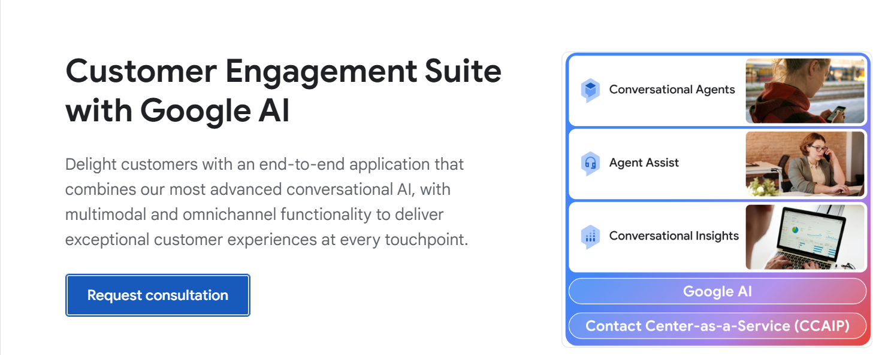
Screenshot of Application

Slide 7
Healthcare - Google Deepmind - CoDoC
References
Google DeepMind - CoDoC for Healthcare
CoDoC Code on Github
Video Explanation: CoDoC's Impact on Medical AI
Notes:
CoDoC(Complementarity-driven Deferral-to-Clinical Workflow)

Slide 8
Use Case
CoDoC, developed by DeepMind, enhances the reliability of AI in medical image interpretation by learning when to defer to human clinicians. It works with existing AI models to assess their confidence and determine whether to trust the AI's output or rely on human expertise. For example, in breast cancer screening, CoDoC reduced false positives by 25% without missing any true positives, improving accuracy and reducing clinician workload by allowing AI to handle cases where it is more accurate.
Notes:
### Speaker Notes
Wayve Technologies is pioneering the development of AI foundation models for autonomous driving, focusing on *Embodied AI* to enhance the safety and adaptability of driving automation. Their **AV2.0 approach** replaces the traditional sense-plan-act model of autonomous vehicles (AV1.0) with an end-to-end neural network that learns directly from raw data using self-supervised learning. This enables AV2.0 to operate without relying on HD maps and adapt across different vehicles and environments.
Key innovations include:
- **Fleet Learning Loop**: A continuous cycle of data collection, model training, and deployment to enhance real-world driving capabilities.
- **LINGO**: A vision-language model that improves the interpretability and training of AI, offering insights into decision-making.
- **GAIA**: A generative world model that simulates driving scenarios, improving training and validation through realistic video generation.
Their technology promises scalable, safer autonomous driving, supported by collaborations with major players like Microsoft to build advanced supercomputing infrastructure.

Slide 9
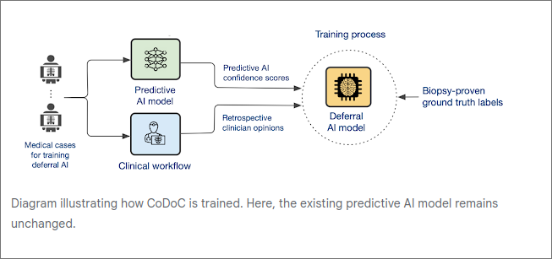
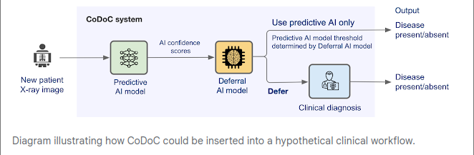
Diagram of Application’s Business Logic
Notes:
Speaker Notes
### Diagram 1: **Training CoDoC**
- **Input 1:** Predictive AI outputs a confidence score between 0 (no disease) and 1 (disease present).
- **Input 2:** Clinician’s interpretation of the medical image.
- **Input 3:** Ground truth of disease presence, confirmed through follow-up (e.g., biopsy).
- **Process:** CoDoC learns how accurate the AI model is relative to the clinician based on these three inputs.
- **Outcome:** CoDoC determines when to trust the AI's decision or when to defer to the clinician, based on the AI’s confidence scores.
### Diagram 2: **Inserting CoDoC into Clinical Workflow** (Breast Cancer Example)
- **Step 1:** A new **breast cancer x-ray** is evaluated by the AI, which generates a confidence score indicating the likelihood of cancer being present.
- **Step 2:** CoDoC processes this confidence score to determine whether to accept the AI’s diagnosis or defer the decision to a clinician.
- **Step 3:** This ensures that the **final breast cancer diagnosis** is as accurate as possible, relying on the AI when confident and deferring to the clinician when necessary. This process helps reduce errors while maintaining efficiency in diagnosis.

Slide 10
Key Prompts
1. "What is the AI's confidence score for this medical image?"
- The MLLM would retrieve the AI model's confidence score, a number between 0 and 1, representing how certain the AI is that a disease is present.
2. "What is the clinician's diagnosis for this case?"
- The model would reference the clinician's interpretation of the image, comparing it with the AI's assessment.
3. "Is there a discrepancy between the AI and the clinician's diagnosis?"
- This prompt would help the MLLM identify whether the AI's decision deviates from the clinician's judgment, signaling whether further action is required.
4. "Should CoDoC defer this decision to the clinician?"
- This is where the MLLM assesses if CoDoC should step in, based on the confidence score, clinician's input, and other contextual factors.
5. "What is the ground truth diagnosis?"
- The model looks for the actual outcome of the case (e.g., biopsy results) to compare with the AI and clinician’s predictions, helping to train CoDoC on when to defer or accept AI conclusions.

Slide 11
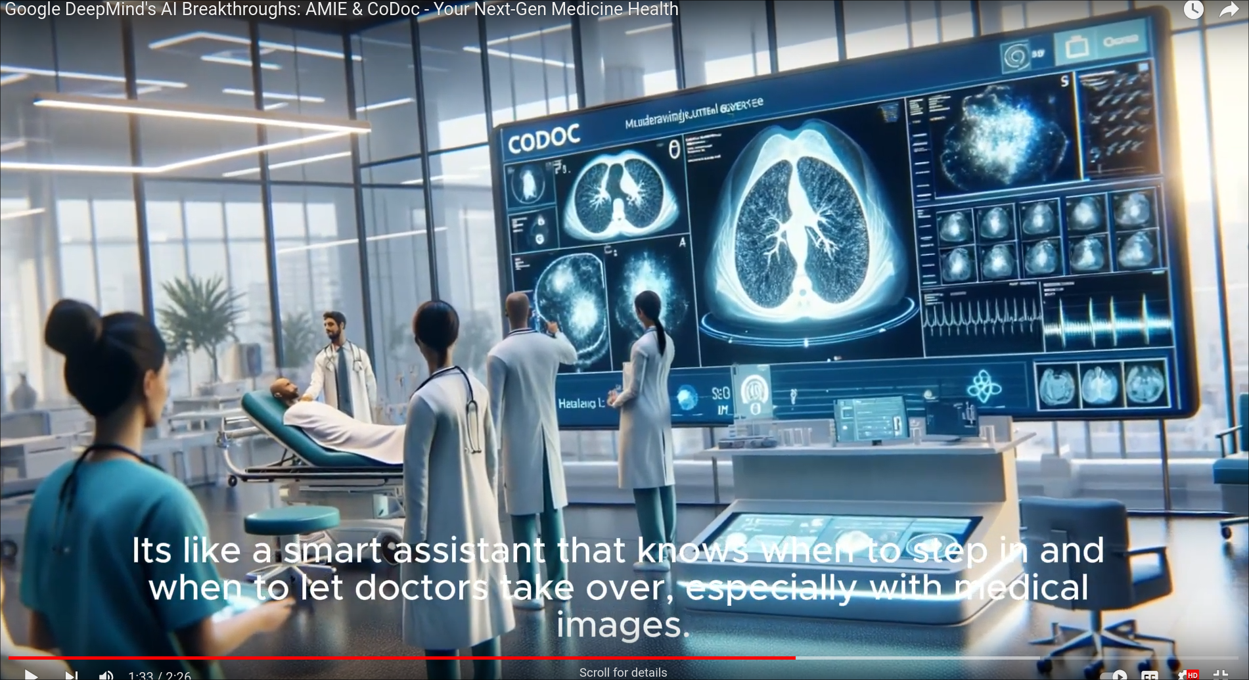
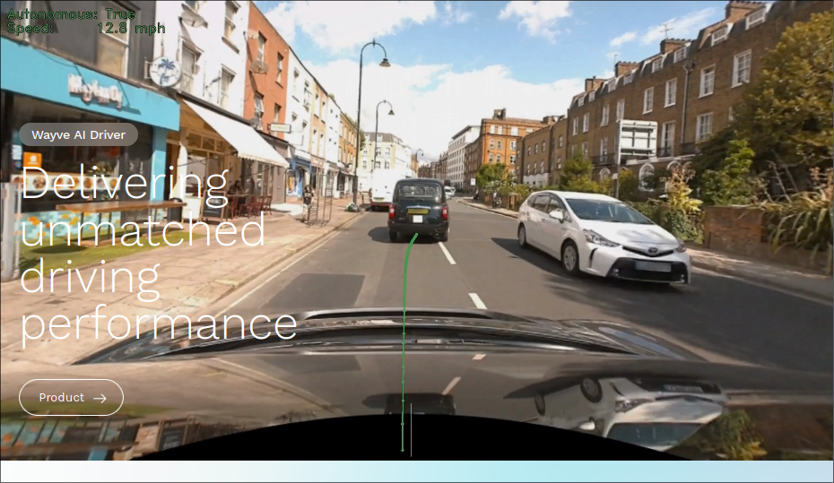
Screenshot of Application

Slide 12
Education - Synthesia
References
https://www.researchgate.net/figure/Architecture-of-the-application_fig5_378772107
https://www.synthesia.io/case-studies/spirit-airlines
https://www.synthesia.io/case-studies/berlitz
Services
Avatar builder
Text-to-Video
Multimodal Context - the integration of text, images, etc
Language Support
Easy Editing

Slide 13
Use Case
Spirit Airlines decreased phone support inquires by 76% with AI video
https://www.synthesia.io/case-studies/spirit-airlines
Berlitz creates language training videos 70% faster
https://www.youtube.com/watch?v=pHo0VJF6DJA

Slide 14
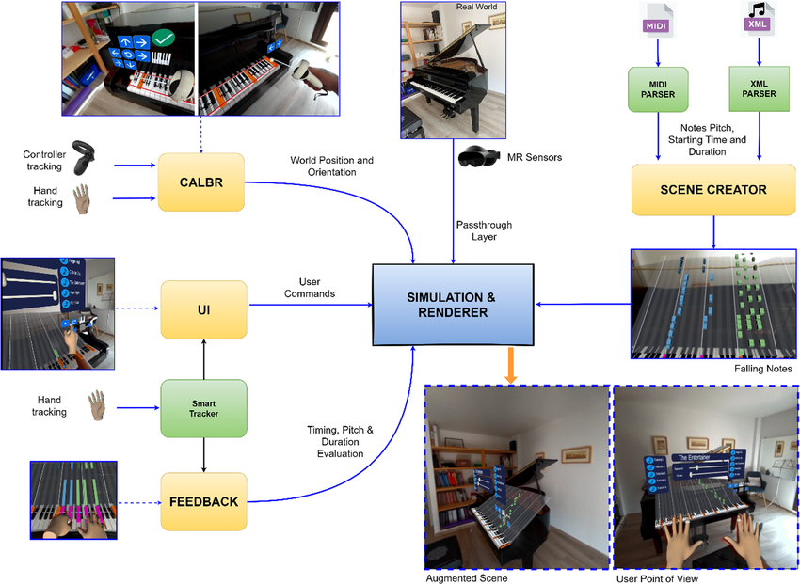
Diagram of Application Business Logic

Slide 15
Key Prompts
Possible Key Prompts:
Create a 2 -minute video introducing the benefits of Synthesia to potential customers
Produce a video script for announcing our new sustainability initiative to all employees
Translate the following script into Japanese and generate a video featuring a native-speaking avatar : [script]

Slide 16
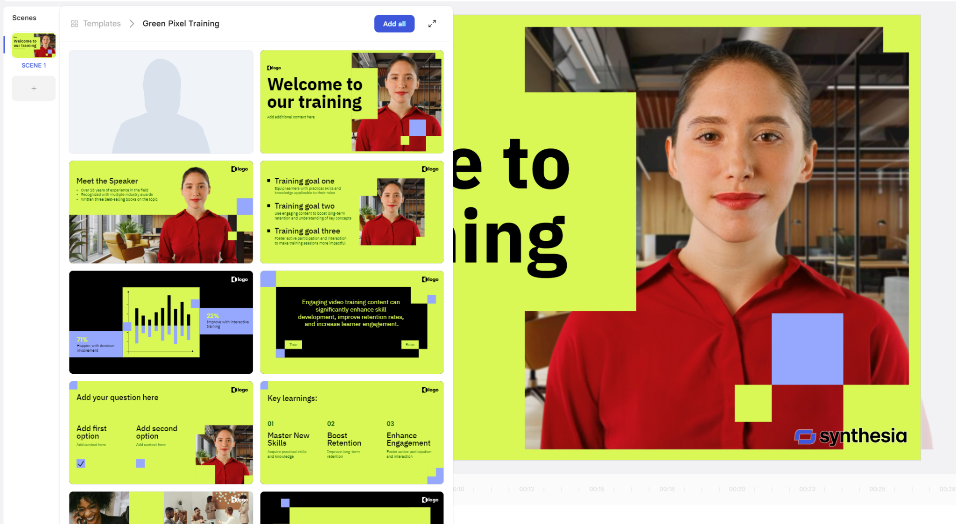
Screenshot of Application
Choose theme of your video
E.g. Training, Product
Choose Template
Choose layout from the list
Add Script

